Slide 1
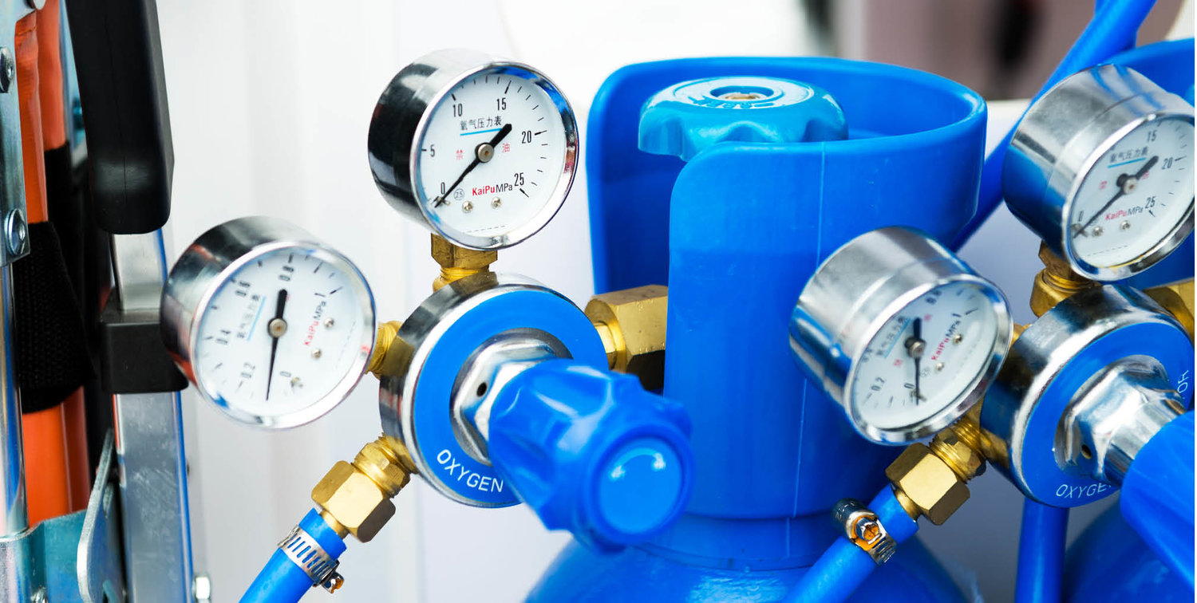



MADHYA PRADESH MEDICAL & INDUSTRIAL OXYGEN MARKET
Feb, 2022
Prepared for:
www.chemanalyst.com
MARKET INTELLIGENCE . CONSULTING

Slide 2
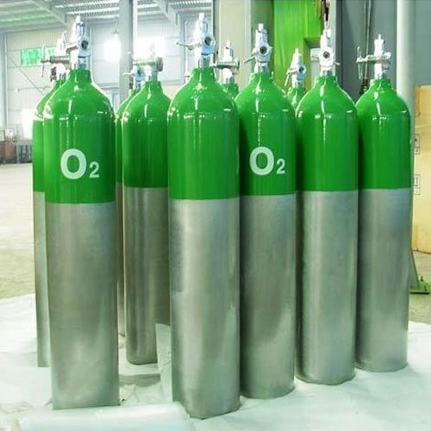
Project Outline and Background
Bharat Oman Refineries Limited was incorporated in 1994 as a Public Limited Company with equal equity participation of Bharat Petroleum Corporation Limited (“BPCL”, a Government of India Undertaking) and OQ (formerly OOC). Presently, BPCL is holding 63.4% and OQ is holding 36.6% equity in the Company. The company has become subsidiary of BPCL effective from 1st April, 2020. The Government of Madhya Pradesh is also stakeholder in the Company. Since commissioning, the Company has achieved significant milestones and has recently implemented the debottlenecking project to enhance capacity from 6.0 to 7.8 MMTPA with capability to produce 100% BS-VI specifications fuel. BORL wants to diversify into specialty chemicals business having lower capex and high margin opportunities.
The client is looking for a customized study to identify possibilities for marketing of medical and industrial oxygen within 200 KM radius of Bina, Madhya Pradesh

Slide 3


Scope of Work

Slide 4
Product: Oxygen
Oxygen is an odourless gas which is necessary to maintain life. It is widely used in medical sector to:
Provide basis for all modern anesthetic techniques
Improve tissue oxygen tension by enhancing oxygen availability in different circumstances such as
Rib fracture and chest wound
Hyperpyrexia, carbon monoxide poisoning, accident & trauma cases
During cardiac arrest and sudden respiratory disorder
Treat severe headache and during newborn resuscitation
Table 1: General Properties of Medical Oxygen
Table 2: Specification for Compressed Medical Oxygen
Property | Remark
Physical | Odourless & colourless gas
Molecular Weight | 32
Boiling Point | –183°C (at 1 bar)
Density | 1.335 kg/m3 (at 15 °C)
Shelf Life | 36 Months
Parameter | Remark
Grade | Medical grade I.P.
Purity | Certified pure 99-100%
Damage Factor | Should not cause any damage to the materials of cylinders, gas pipeline, Anesthesia machine and ventilators.
Application | Certified safe for human use

Slide 5
Table of Contents
S. No. | Contents
1. | Product Overview
2. | Research Methodology
3. | Executive Summary
Madhya Pradesh Industrial Oxygen Market (Market assessment and forecast, its distribution, related price points and purchase terms)
4. | Madhya Pradesh Industrial Oxygen Market Outlook (2022-2037)
 | 4.1. | List of Major Demand Centers for Industrial Oxygen and No. of industrial units/factories in 200 Km radius along with their oxygen demand (in MT/Day)
 |  | 4.1.1. | Small
 |  | 4.1.2. | Medium
 |  | 4.1.3. | Large
 | 4.2. | Historical Demand of Industrial Oxygen
 |  | 4.2.1. | No of Factories
 |  | 4.2.2. | Approximate Oxygen Demand Per Factory (MT / Day)
Madhya Pradesh Medical Oxygen Market (Market assessment and forecast, its distribution, related price points and purchase terms)
5. | Madhya Pradesh Medical Oxygen Oxygen Market Outlook (2022-2037)
 | 5.1. | List of Major Demand Centers for Medical Oxygen and No. of hospitals in 200 Km radius along with their medical oxygen demand (in MT/Day)
 |  | 5.1.1. | Small
 |  | 5.1.2. | Medium
 |  | 5.1.3. | Large

Slide 6
Table of Contents
S. No. | Contents
 | 5.2. | Historical Demand of Industrial Oxygen
 |  | 5.2.1. | No of Factories
 |  | 5.2.2. | Approximate Oxygen Demand Per Factory (MT / Day)
6. | Madhya Pradesh Cylinder Oxygen Pricing Analysis
 | 6.1. | Historical Prices – Industrial (2019-2021)
 | 6.2. | Historical Prices – Medical (2019-2021)
7. | Practices for procurement of Medical Gases
 | 7.1. | Payment Terms
 | 7.2. | Contract Duration
 | 7.3. | Procurement Process
 | 7.5. | Rental on Cylinder (Monthly / Annual Charges)
8. | Strategic Recommendations
 | 8.1. | Key Industrial Cluster to target
 | 8.2. | Logistics & Supply Chain Strategies
 | 8.3. | Pricing Strategies

Slide 7

Research Methodology

Slide 8
Research Methodology
Market Profiling
Formulating Questionnaire
Developing List of Respondents
Data Collection
Data Validation
Data Analysis
In-depth secondary research will be conducted to determine top players in the India Medical and Industrial Oxygen market, consumption behavior and segmental market share.
In order to conduct industry experts’ interviews, ChemAnalyst will formulate a detailed discussion guide.
List of industry players and industry specialists will be developed.
ChemAnalyst will conduct interviews with industry experts and industry players for data collection and verification.
Data obtained as a result of primary and secondary research will be validated through rigorous triangulation.
The data will be scrutinized using MS-Excel, statistical tools and internal proprietary database to obtain qualitative and quantitative insights.
Primary Research
Desk Research
Company Analysis
Actionable
Insights
Identifying Key Opinion Leaders
Questionnaire Design
In-depth Interviews
Recent Developments
Market Changing Aspects/Dynamics
Government Policies
Conclusion
Market Participants
Key Strengths
Data
Collection
Data Filter
& Analysis
Research &
Intelligence
Business
Solution
Primary Research
Secondary Research
Paid Sources
LinkedIn
ChemAnalyst Internal Database
Company Websites
Company Annual Reports
White Paper Study
Financial Reports
Investor Presentations
Regulatory Body
Associations, etc.
Factiva
Hoovers

Slide 9
Research Methodology
The recommended methodology for this study is primary research followed by exhaustive Secondary Research.
Phase 1: Chemanalyst will design interview questionnaires for manufacturers, suppliers, end-users, government organisations and industry experts. The objective of these questionnaires would be to understand the market dynamics, emerging trends and competitor analysis specialty chemical market
For Example—Contrcat manufcturing providerswill be targeted to know market, market share by types, by sales, by region, market trends, etc.
Post receiving feedback / approval from Client on questionnaires , Chemanalyst will start executing the surveys across said target audience. Chemanalyst will also conduct mock surveys across target respondents to check the feasibility of the questionnaires and to address the challenges faced, if any, while conducting the surveys and in data collection.
Primary research surveys will be conducted with the identified companies, and they will also be asked for their other competitors in the market. By this way if we may have missed any target company due to limitations of secondary research then we will be able to identify that company and then survey them as well.,
Chemanalyst will also identify channel partners such as distributors, traders and agents
Below mentioned is the number of surveys that would be conducted during the study :
Stakeholders | Manufacturers | End-User | Industry Experts | Regulatory Bodies | Total
Specialty Chemicals | 45 | 200 | 10 | 10 | 225
We do multiple interviews in one organisation at different levels (Mid-Senior) and departments (Sales, Marketing, Production, etc)

Slide 10

Research Methodology
Phase 2: ChemAnalyst will execute primary surveys. In addition, exhaustive secondary research will be done using various credible sources such as company annual reports, white papers, investor presentations, financial reports, international trade associations, etc.
Phase 3: Chemanalyst will perform periodical checks on data being collected through surveys with logic checks and analyze survey results in MS Excel/SPSS and data generated through its proprietary database.
Chemanalyst will also use data triangulation technique to fill the gaps and to present the more meaning picture of the market. In order to forecast the Ride-Hailing market, ChemAnalyst will use various forecast techniques such as: Moving Average, Regression analysis, etc.
ChemAnalyst will also use its own forecast tool, which is based on the growth of various allied industries. Chemanalyst will also use impact analysis during short, medium and long term to estimate the demand and to reach to an accurate market numbers
Phase 4: ChemAnalyst will deliver the final comprehensive project report in detailed PowerPoint Presentation format along with the support documents
Investment information will be sourced from published literature and will be adjusted it for the timeline and the location factors. An assessment will be made for the likely import component based on the materials of construction and type of equipment.

Slide 11
Research Methodology
ChemAnalyst will use its own forecast tool, which is based on the growth of various allied industries located in radius of 200 KM from Bina, Madhya Pradesh refinery. ChemAnalyst will also use the impact analysis during short, medium- and long-term period to estimate the demand and to reach accurate market numbers.
Partial List of Companies to be Interviewed | Key Secondary Sources
Linde India Limited Inox Air Products Goyal MG Gases Private Ltd Malwa Oxygen & Industrial Gases Private Limited Steel Authority of India Limited Sarthak Metals Marketing Pvt. Ltd. Air Liquide S.A. Bharat Heavy Electricals Limited Jindal Steel & Power Limited Chambal Fertilizers & Chemicals Limited AIIMS, Bhopal Bhopal Heart & General Hospital Ltd Ellenbarrie Industrial Gases Limited Bhuruka Gases Limited Uttam Air Products Private Limited Techno Udyog | World Bank ChemAnalyst Research Proprietary Database & Knowledge Repository Company Annual Reports Industry Magazines Industry Reports News Dailies Credible Paid Databases BP Statistics OPEC Bulletin OECD WHO Ministry of Health and Family Welfare, Government of India Un Comtrade Director General of Foreign Trade

Slide 12
Madhya Pradesh Oxygen Market Outlook
Madhya Pradesh Oxygen Demand, By Volume, FY2019 - FY2037F (Million Cubic Meter)
Madhya Pradesh Oxygen Demand, By Type, By Volume, FY2019 - FY2037F (Million Cubic Meter)
By Type | 2019 | 2020 | 2021 | 2022E | 2023F | 2024F | 2025F | 2026F | 2027F | 2028F | 2029F | 2030F | 2031F | 2032F | 2033F | 2034F | 2035F | 2036F | 2037F
Industrial Oxygen | 168.48 | 187.62 | 182.44 | 25.08 | 70.94 | 157.73 | 226.32 | 309.63 | 355.85 | 442.18 | 490.20 | 524.75 | 568.62 | 599.28 | 624.12 | 651.43 | 678.94 | 706.47 | 734.42
Medical Oxygen | 49.08 | 60.91 | 145.99 | 538.48 | 493.41 | 414.80 | 360.76 | 293.12 | 266.37 | 202.87 | 184.26 | 178.86 | 164.61 | 164.23 | 170.23 | 173.58 | 176.69 | 180.39 | 183.83
Year depicts the fiscal year ending in the month of March of that year.
2021 – April 2020-March 2021

Slide 13
Madhya Pradesh Oxygen Market Outlook
Madhya Pradesh Oxygen Demand, By Type, By Volume, FY2019 - FY2037F
Year depicts the fiscal year ending in the month of March of that year.
2021 – April 2020-March 2021
With the rise of Covid-19 patients in the Madhya Pradesh, oxygen demand increased every day leading to a huge demand supply gap.
Due to the huge rise in the demand of medical oxygen, Government of Madhya Pradesh regulated the supply of oxygen with converting whole of industrial oxygen to medical oxygen.
The industrial units were advised to obtain oxygen from alternate measures such as import of oxygen or setting up their own Air separation units for generation of oxygen for their captive requirements.

Slide 14
Madhya Pradesh Industrial Oxygen Market Outlook
Madhya Pradesh Industrial Oxygen Demand, By Volume, FY2019 - FY2037F (Million Cubic Meter)
Madhya Pradesh Industrial Oxygen Demand, By Type of Factory, By Volume, FY2019 - FY2037F (Million Cubic Meter)
By Type Of Factory | 2019 | 2020 | 2021 | 2022E | 2023F | 2024F | 2025F | 2026F | 2027F | 2028F | 2029F | 2030F | 2031F | 2032F | 2033F | 2034F | 2035F | 2036F | 2037F
Small | 47.46 | 48.05 | 24.54 | 0.73 | 6.05 | 21.39 | 37.48 | 63.57 | 83.77 | 109.09 | 127.11 | 140.53 | 152.67 | 163.66 | 171.32 | 179.40 | 187.93 | 195.34 | 202.41
Medium | 54.49 | 53.71 | 26.69 | 0.81 | 6.77 | 24.72 | 48.55 | 77.01 | 98.32 | 130.13 | 148.24 | 161.26 | 175.99 | 188.47 | 198.72 | 208.65 | 220.18 | 232.22 | 247.06
Large | 66.53 | 85.85 | 131.21 | 23.54 | 58.12 | 111.63 | 140.29 | 169.06 | 173.76 | 202.96 | 214.86 | 222.97 | 239.96 | 247.14 | 254.08 | 263.37 | 270.83 | 278.91 | 284.95
Year depicts the fiscal year ending in the month of March of that year.
2021 – April 2020-March 2021

Slide 15
Madhya Pradesh Industrial Oxygen Market Outlook
Madhya Pradesh Industrial Oxygen Demand, By Type of Factory, By Volume, FY2019 - FY2037F
Year depicts the fiscal year ending in the month of March of that year.
2021 – April 2020-March 2021
Large factories majorly steel industries contributes to the largest demand of industrial oxygen in the state as according to norm per ton of steel requires around 110 m^3 of oxygen. Furthermore, Madhya Pradesh has currently nine private players in the production of steel which further stimulated the demand of oxygen in the large factories.
In FY 2022, due to sudden rise of Covid-19 cases, the supply to the medium and small-scale industries were stopped.

Slide 16
Madhya Pradesh Industrial Oxygen Market Outlook
Madhya Pradesh Oxygen Demand, Y-O-Y Growth, FY2019 - FY2037F
Madhya Pradesh Industrial Oxygen Demand, Y-O-Y Growth, FY2019 - FY2037F

Slide 17
Madhya Pradesh Industrial Oxygen Market Outlook
List of Major Demand Centers for Industrial Oxygen and No. of industrial units/factories in 200 Km radius along with their oxygen demand (in m^3/Day)
Small Company | Demand (m^3/Day)
Rathi Iron & Steel Industries Ltd. | 400
Lohiya Steel and Steel | 350
Trijal Iron and Steel Co. | 400
Narmada Steel Tubes | 325
K.G. Iron and Steel Casting Pvt. Ltd. | 550
Betul Press Steel Industries | 300
Jain’s Steel Industry | 440
Alpha Iron & Steel | 560
Sanjay Steel Industries | 300
Sarkar Steel Industries Pvt. Ltd. | 350
National Steel Industries | 460
Shri Ram Iron Industry | 500
Trimula Industries Ltd. | 550
Mp. Iron Industries | 600

Slide 18
Madhya Pradesh Industrial Oxygen Market Outlook
List of Major Demand Centers for Industrial Oxygen and No. of industrial units/factories in 200 Km radius along with their oxygen demand (in m^3/Day)
Medium Company | Demand (m^3/Day)
Lahari Power & Steels Ltd (Suryachakra Group) | 2000
National Steel & Agro Industries Ltd (Ruchi Group) | 3000
Simplex Tubular Structure Pvt Ltd | 1000
Sarda Energy & Minerals Ltd | 2500
Nipani Industries | 3020
Ruchi Strips and Alloys Ltd. | 2000
S D Bansal Iron and Steel Pvt Ltd | 2400
Mittal Group of Companies | 2300
Sun Ultra Technologies Pvt Ltd | 2100
National Steel & Agro Industries Ltd (Ruchi Group) | 1900
Ganesh Industries | 2300
Sarda Energy & Minerals Ltd | 2100
RKSK Steel India Ltd | 3000
Ruchi Global Ltd | 3400
S D Bansal Iron and Steel Pvt Ltd | 3500

Slide 19
Madhya Pradesh Industrial Oxygen Market Outlook
List of Major Demand Centers for Industrial Oxygen and No. of industrial units/factories in 200 Km radius along with their oxygen demand (in m^3/Day)
Large Company | Demand (m^3/Day)
Mahamaya Steel Industries Ltd | 9900
Malanpur Steel Ltd | 9000
Pithampur Steels Ltd | 16500
Steel Tubes Of India Ltd | 8000
Surya Gases pvt Ltd | 10500
Vinayak gases ltd | 9600
Inert Cryogenics and Allied gasses | 7000
Inheart gasses pvt ltd | 7500
Audhyogic gases pvt ltd | 8040
Malwa oxygen and industrial gases | 9300
Dewas gasses ltd | 10000
M/s Bharti Air Product, Bhopal | 9000
M/s Niket Udyog Limited, Chhindwara | 10500
M/s Rewa Gases Pvt Ltd, Singrauli | 12000
Grey Iron Foundry, Jabalpur | 18000

Slide 20
Madhya Pradesh Medical Oxygen Market Outlook
Madhya Pradesh Medical Oxygen Demand, By Volume, FY2019 - FY2037F (Million Cubic Meter)
Madhya Pradesh Medical Oxygen Demand, By Type of Factory, By Volume, FY2019 - FY2037F (Million Cubic Meter)
By Type Of Hospitals | 2019 | 2020 | 2021 | 2022E | 2023F | 2024F | 2025F | 2026F | 2027F | 2028F | 2029F | 2030F | 2031F | 2032F | 2033F | 2034F | 2035F | 2036F | 2037F
Small | 7.62 | 11.24 | 31.43 | 171.02 | 139.83 | 113.86 | 97.48 | 77.15 | 68.91 | 52.22 | 47.37 | 45.84 | 42.16 | 41.99 | 43.44 | 44.28 | 45.02 | 45.91 | 46.69
Medium | 11.62 | 16.65 | 44.77 | 233.97 | 195.19 | 155.47 | 128.68 | 95.70 | 85.35 | 65.04 | 59.09 | 57.45 | 52.91 | 52.85 | 54.83 | 55.95 | 57.00 | 58.21 | 59.40
Large | 29.84 | 33.02 | 69.78 | 133.49 | 158.38 | 145.47 | 134.60 | 120.27 | 112.12 | 85.61 | 77.80 | 75.57 | 69.55 | 69.39 | 71.96 | 73.36 | 74.67 | 76.27 | 77.74
Year depicts the fiscal year ending in the month of March of that year.
2021 – April 2020-March 2021

Slide 21
Madhya Pradesh Medical Oxygen Market Outlook
Madhya Pradesh Medical Oxygen Demand, By Type of Hospital, By Volume, FY2019 - FY2037F
Year depicts the fiscal year ending in the month of March of that year.
2021 – April 2020-March 2021
Large factories majorly steel industries contributes to the largest demand of industrial oxygen in the state as according to norm per ton of steel requires around 110 m^3 of oxygen. Furthermore, Madhya Pradesh has currently nine private players in the production of steel which further stimulated the demand of oxygen in the large factories.
In FY 2022, due to sudden rise of Covid-19 cases, the supply to the medium and small-scale industries were stopped.

Slide 22
Madhya Pradesh Medical Oxygen Market Outlook
Madhya Pradesh Oxygen Demand, Y-O-Y Growth, FY2019 - FY2037F
Madhya Pradesh Medical Oxygen Demand, Y-O-Y Growth, FY2019 - FY2037F

Slide 23
Madhya Pradesh Medical Oxygen Market Outlook
List of Major Demand Centers for Industrial Oxygen and No. of industrial units/factories in 200 Km radius along with their oxygen demand (in m^3/Day)
Small Company | Demand (m^3/Day)

Slide 24
Madhya Pradesh Medical Oxygen Market Outlook
List of Major Demand Centers for Industrial Oxygen and No. of industrial units/factories in 200 Km radius along with their oxygen demand (in m^3/Day)
Medium Company | Demand (m^3/Day)

Slide 25
Madhya Pradesh Medical Oxygen Market Outlook
List of Major Demand Centers for Industrial Oxygen and No. of industrial units/factories in 200 Km radius along with their oxygen demand (in m^3/Day)
Large Company | Demand (m^3/Day)

Slide 26

Pricing Analysis

Slide 27
Pricing Analysis
Madhya Pradesh Industrial and Medical Oxygen Pricing Analysis (INR/m^3) FY2019 - FY2021
Source: ChemAnalyst
The escalating demand of medical oxygen during second wave of Covid-19 owing to massive surge in Covid-19 cases, an acute shortage of medical oxygen was witnessed across the country which surged the prices of oxygen at all levels. Moreover, the shoot up in the prices of electricity also impacted the prices of oxygen. The freight charges are generally 2 - 3 cubic per m^3. However, the freight charge is higher for the hospital situated in hilly region and remote location. If the monthly consumption of liquid Medical Oxygen is high for a hospital (within city), then gas producing company charges minimal charge per carrier which carries around 50-100 cylinders (approximately INR500-1000).

Slide 28
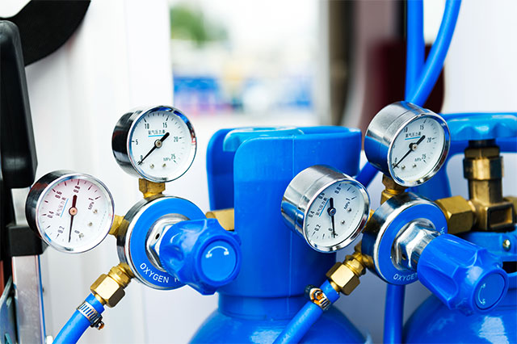
Practices for Procurement of
Medical Gases

Slide 29
Practices for Procurement of Medical Gases: Private Hospital
Procurement Process | Suppliers approach private hospitals showcasing their credentials and reliability to their prospect customers and submit techno commercial proposals as per the volume requirement of the hospitals. Hospitals prefer to have more than one supplier to ensure uninterrupted supply and better price negotiations. Distributors are also authorized to approach hospitals to submit techno commercial proposals.
Contract Duration | Contract duration for a Private hospital is usually 5 years (4+1). One year is an extended duration based on the performance.
Payment Terms | Approximately 30-45 days credit period is applicable from the invoice date. Private hospitals usually make payment through demand draft or RTGS transfer. When there is a distributor role in the value chain, the gas manufacturing company asks for advance payment from the distributor or it provides a 15-day credit time.
Rental on Cylinder (Monthly/ Annual Charges)
Rental on Tank (Facility Charge)
Products | Daily Rent | Fixed Rent/Month
Large oxygen cylinder | INR5-6 | Rent for cylinder starts after 10 days from delivery date of cylinder at the rate of INR5-6/day
Small oxygen cylinder | In most of the cases, hospitals purchase gas with small cylinders.
Tank Size (Liquid Medical Oxygen) | Fixed Rent/Month
5000 m³ | INR10000-12000
5000 m³ - 10000 m³ | INR12000-17000
10000 m³ - 15000 m³ | INR17000-22000

Slide 30
Practices for Procurement of Medical Gases: Public Hospital
Procurement Process | Public hospitals publish/issue tenders based on specific requirement with pre-defined terms and conditions. Evaluation of bidders is based on technical capabilities followed by commercials. Government hospitals set eligibility criteria for bidders to be eligible for bids. Distributors are also authorized to bid for tenders. Public hospitals prefer to have more than one supplier.
Contract Duration | Contract duration is usually 3 years (2+1). One year is an extended duration based on the performance. Public hospitals are bound to go for fresh bidding after 3 year (maximum), even if they are satisfied with existing suppliers.
Payment Terms | Approximately 90 days credit period is applicable from the invoice date as a prominent practice, there are cases where it is extended up to 6 months Public hospitals usually make payment through demand draft or RTGS transfer. When there is a distributor role in the value chain, the gas manufacturing company asks for advance payment from the distributor or it provides a 15-day credit time.
Rental on Cylinder (Monthly/ Annual Charges)
Rental on Tank (Facility Charge)
Products | Daily Rent | Fixed Rent/Month
Large oxygen cylinder | INR5-6 | Rent for cylinder starts after 10 days from delivery date of cylinder at the rate of INR5-6/day
Small oxygen cylinder | In most of the cases, hospitals purchase gas with small cylinders.
Tank Size (Liquid Medical Oxygen) | Fixed Rent/Month
5000 m³ | INR10000-12000
5000 m³ - 10000 m³ | INR12000-17000
10000 m³ - 15000 m³ | INR17000-22000

Slide 31
Practices for Procurement of Medical Gases: Public Hospital
Public Hospital Medical Oxygen Tendering Process in India – Flowchart
Preparation/Design of Request for Proposal (RFP)
Internal technical and procurement team prepare and fianlise the scope of requirement
Typical Structure of RFP
Product/Technical Specification
Terms and Conditions to supply medical gases
Eligibility Criteria for bidders
Parameters/formula to evaluate bids
Financial Bid Structure
Submission guidelines
Publication of RPF at Government Portal/ Hospital Website/Newspapers
(in form of tender)
Revisit RFP
and Issue an updated version if required.
Call for Pre-Bid Meeting
(Objective is to clarify any concern bidders may have related with RFP)
Representative Standard Parameters/ Eligibility Criteria for Bidders
Specific duration of operation to serve public hospitals
Defined turnover of the bidder
Must not be blacklisted as per the records of Ministry of Commerce
Infrastructure and logistics capabilities
Documentary evidence showcasing past supply records to government hospitals
Bid Submission
Physical Document Submission
(Ask bidders to submit technical and commercial bid in separate envelopes in predefined format)
Government e-Tender Portals to submit online bids** in predefined format as per the RFP
Selection on Technical Aspects Only
Internal technical and procurement team only reviews technical proposal and shortlist bidders
Shortlisted bidders are invited to open financial bid at their office on a specific date
Selection on Technical + Commercial Aspects
Internal technical and procurement team reviews bids and give scores to all bidders to select wining bid/bidders. In few cases the evaluation of financial and technical bids are done in presence of all bidders
Financial bids are opened in presence of all bidders the lowest commercial bidder gets awarded the supply contract.
**Some of the tender portals are E Procurement Portal, Tender Detail, Tender Tiger etc
Source: ChemAnalyst

Slide 32
Practices for Procurement of Medical Gases: Public Hospital
Representative Standard Parameters/ Eligibility Criteria for Bidders
Specific duration of operation to serve public hospitals
A bidder should have served the public hospitals for specific duration of operational activities so that the bidder must have some experience in supplying to government hospitals.
Defined turnover of the bidder
There is a minimum turnover criteria for the bidders to apply for the tendering process.
Must not be blacklisted as per the records of Ministry of Commerce
The bidder should not be blacklisted by the Ministry of Commerce as it would affect the reputation of the bidder.
Infrastructure and logistics capabilities
The bidder should have the enough capabilities of infrastructure and logistics so that it may serve the demand of medical oxygen in government hospitals.
Documentary evidence showcasing past supply records to government hospitals
There should be a proper evidence of records that the bidder had previously served the government hospitals for the tendering process.
Total Healthcare Spending Market in India, FY2022, FY2025F and FY2030F, (USD Billion)
132.84
144.21
155.92
Source: ChemAnalyst

Slide 33






























Our Prestigious Clients Who Bought Reports in Chemical Industry

Slide 34
About Us & Disclaimer
ChemAnalyst is a Middle East market research and consulting company with offices in the US, UK and India. ChemAnalyst provides market research reports in number of areas to organizations. The company uses innovative business models that focus on improving productivity, while ensuring creation of high-quality reports. The proprietary forecasting models use various analyses of both industry-specific and macroeconomic variables on a state-by-state basis to produce a unique ‘bottom-up’ model of a country, regional and Middle East industry prospects. Combined with the detailed analysis of company activity and industry trends, the result is a uniquely rich evaluation of the opportunities available in the market.
Related Reports
Asia-Pacific Water and Wastewater Treatment Chemicals Market By Application (Power, Oil & Gas, Wastewater & Others), By Type (Coagulants & Flocculants, pH Adjusters & Softeners & Others), By Country, Competition Forecast & Opportunities, 2013 – 2027
Middle East Membrane Element Market By Configuration (Spiral Wound, Plate & Frame and Others), By Membrane Type (Reverse Osmosis, Ultrafiltration, Microfiltration and Nanofiltration), By Application, By Region, Competition, Forecast & Opportunities, 2014 – 2026
ChemAnalyst – North America
708 Third Avenue, Manhattan,
New York, United States
Tel: +1- 646- 360- 1656
Email: sales@chemanalyst.com www.chemanalyst.com
ChemAnalyst – Europe
54, Old brook, Bretton,
Peterborough,
United Kingdom
Email: sales@chemanalyst.com www.chemanalyst.com
ChemAnalyst – Asia-Pacific
B – 44, Sector – 57, Noida, National Capital Region, U.P. - India
Tel: +91-120-4523900
Email: sales@chemanalyst.com www.chemanalyst.com
Disclaimer
The contents of this report are based on information generally available to the public from sources believed to be reliable. No representation is made that it is timely, accurate or complete. ChemAnalyst has taken due care and caution in compilation of data as this has been obtained from various sources including which it considers reliable and firsthand. However, ChemAnalyst does not guarantee the accuracy, adequacy or completeness of any information and it is not responsible for any errors or omissions or for the results obtained from the use of such information and especially states that it has no financial liability whatsoever to the subscribers / users of this report. The information herein, together with all estimates and forecasts, can change without notice. All the figures provided in this document are indicative of relative market size and are strictly for client’s internal consumption. Usage of the same for purpose other than internal will require prior approval of ChemAnalyst.

